Slide 1
Parallel Computing Platforms
Dr. Nausheen Shoaib

Slide 2
Scope of Parallelism
Conventional architectures coarsely comprise of a processor, memory system, and the datapath.
Each of these components present significant performance bottlenecks.
Parallelism addresses each of these components in significant ways.
Different applications utilize different aspects of parallelism - e.g., data itensive applications utilize high aggregate throughput, server applications utilize high aggregate network bandwidth, and scientific applications typically utilize high processing and memory system performance.
It is important to understand each of these performance bottlenecks.

Slide 3
Implicit Parallelism: Trends in Microprocessor Architectures
Microprocessor clock speeds have posted impressive gains over the past two decades (two to three orders of magnitude).
Higher levels of device integration have made available a large number of transistors.
The question of how best to utilize these resources is an important one.
Current processors use these resources in multiple functional units and execute multiple instructions in the same cycle.
The precise manner in which these instructions are selected and executed provides impressive diversity in architectures.

Slide 4
Pipelining and Superscalar Execution
Pipelining overlaps various stages of instruction execution to achieve performance.
At a high level of abstraction, an instruction can be executed while the next one is being decoded and the next one is being fetched.
This is akin to an assembly line for manufacture of cars.

Slide 5
Pipelining and Superscalar Execution
Pipelining, however, has several limitations.
The speed of a pipeline is eventually limited by the slowest stage.
For this reason, conventional processors rely on very deep pipelines (20 stage pipelines in state-of-the-art Pentium processors).
However, in typical program traces, every 5-6th instruction is a conditional jump! This requires very accurate branch prediction.
The penalty of a misprediction grows with the depth of the pipeline, since a larger number of instructions will have to be flushed.

Slide 6
Pipelining and Superscalar Execution
One simple way of alleviating these bottlenecks is to use multiple pipelines.
The question then becomes one of selecting these instructions.

Slide 7
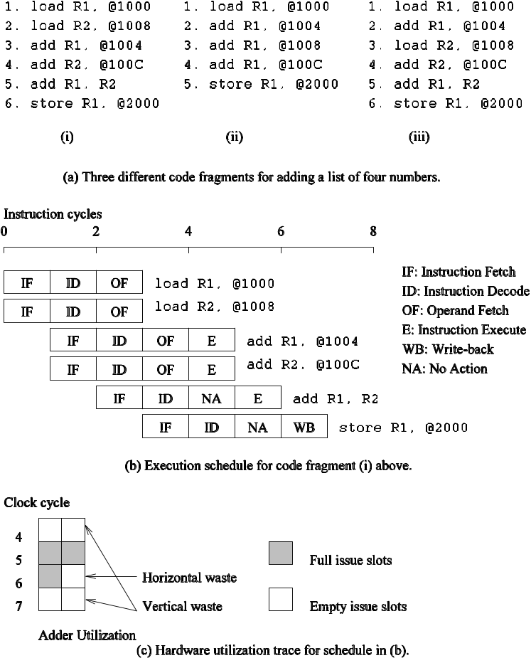
Superscalar Execution: An Example
Example of a two-way superscalar execution of instructions.

Slide 8
Superscalar Execution: An Example
In the above example, there is some wastage of resources due to data dependencies.
The example also illustrates that different instruction mixes with identical semantics can take significantly different execution time.

Slide 9
Superscalar Execution
Scheduling of instructions is determined by a number of factors:
  True Data Dependency: The result of one operation is an input to the next.
  Resource Dependency: Two operations require the same resource.
  Branch Dependency: Scheduling instructions across conditional branch statements cannot be done deterministically a-priori.
  The scheduler, a piece of hardware looks at a large number of instructions in an instruction queue and selects appropriate number of instructions to execute concurrently based on these factors.
  The complexity of this hardware is an important constraint on superscalar processors.

Slide 10
Superscalar Execution:
Issue Mechanisms
In the simpler model, instructions can be issued only in the order in which they are encountered. That is, if the second instruction cannot be issued because it has a data dependency with the first, only one instruction is issued in the cycle. This is called in-order issue.
In a more aggressive model, instructions can be issued out of order. In this case, if the second instruction has data dependencies with the first, but the third instruction does not, the first and third instructions can be co-scheduled. This is also called dynamic issue.
Performance of in-order issue is generally limited.

Slide 11
Superscalar Execution:
Efficiency Considerations
Not all functional units can be kept busy at all times.
If during a cycle, no functional units are utilized, this is referred to as vertical waste.
If during a cycle, only some of the functional units are utilized, this is referred to as horizontal waste.
Due to limited parallelism in typical instruction traces, dependencies, or the inability of the scheduler to extract parallelism, the performance of superscalar processors is eventually limited.
Conventional microprocessors typically support four-way superscalar execution.

Slide 12
Very Long Instruction Word (VLIW) Processors
The hardware cost and complexity of the superscalar scheduler is a major consideration in processor design.
To address this issues, VLIW processors rely on compile time analysis to identify and bundle together instructions that can be executed concurrently.
These instructions are packed and dispatched together, and thus the name very long instruction word.
This concept was used with some commercial success in the Multiflow Trace machine (circa 1984).
Variants of this concept are employed in the Intel IA64 processors.

Slide 13
Very Long Instruction Word (VLIW) Processors: Considerations
Issue hardware is simpler.
Compiler has a bigger context from which to select co-scheduled instructions.
Compilers, however, do not have runtime information such as cache misses. Scheduling is, therefore, inherently conservative.
Branch and memory prediction is more difficult.
VLIW performance is highly dependent on the compiler. A number of techniques such as loop unrolling, speculative execution, branch prediction are critical.
Typical VLIW processors are limited to 4-way to 8-way parallelism.

Slide 14
Limitations of
Memory System Performance
Memory system, and not processor speed, is often the bottleneck for many applications.
Memory system performance is largely captured by two parameters, latency and bandwidth.
Latency is the time from the issue of a memory request to the time the data is available at the processor.
Bandwidth is the rate at which data can be pumped to the processor by the memory system.

Slide 15
Why Memory System as Bottleneck?
Data Access Latency: Accessing data from memory (RAM or storage) takes time. Memory access latency is typically much higher than CPU clock speeds. CPUs can execute instructions at extremely high rates, but they often have to wait for data to be fetched from memory. This waiting time can slow down the overall execution of a program.
Memory Bandwidth: Even if data is available in memory, the rate at which data can be transferred between memory and the CPU (memory bandwidth) can be a limiting factor. If the CPU cannot read data from or write data to memory quickly enough, it will be underutilized.

Slide 16
Why Memory System as Bottleneck?
Cache Hierarchies: Modern processors use cache memory to mitigate some of the memory access latency issues. However, if a program's data access patterns do not effectively utilize the CPU's cache hierarchy, it can result in cache misses, forcing the CPU to access slower main memory.
Memory Contention: In multi-core or multi-processor systems, multiple cores or processors may compete for access to the same memory resources. This contention can lead to performance bottlenecks, especially in multi-threaded or parallel applications.
Virtual Memory: In systems with limited physical RAM, the use of virtual memory (paging or swapping) can introduce additional latency when data needs to be moved between RAM and storage devices.

Slide 17
Solution to Memory Bottleneck
To address memory-related bottlenecks, various techniques are used, including optimizing memory access patterns, utilizing efficient data structures, improving cache utilization, and, in some cases, upgrading hardware to increase memory capacity and bandwidth. Additionally, advancements like high-speed SSDs and persistent memory technologies have been developed to reduce the memory bottleneck for specific workloads.
Overall, understanding and optimizing the memory subsystem is crucial for achieving optimal performance in many computing applications, and it's often a more significant concern than the raw speed of the processor alone.

Slide 18
Memory System Performance: Bandwidth and Latency
It is very important to understand the difference between latency and bandwidth.
Consider the example of a fire-hose. If the water comes out of the hose two seconds after the hydrant is turned on, the latency of the system is two seconds.
Once the water starts flowing, if the hydrant delivers water at the rate of 5 gallons/second, the bandwidth of the system is 5 gallons/second.
If you want immediate response from the hydrant, it is important to reduce latency.
If you want to fight big fires, you want high bandwidth.

Slide 19
Memory Latency: An Example
Consider a processor operating at 1 GHz (1 ns clock) connected to a DRAM with a latency of 100 ns (no caches). Assume that the processor has two multiply-add units and is capable of executing four instructions in each cycle of 1 ns. The following observations follow:
  The peak processor rating is 4 GFLOPS.
  Since the memory latency is equal to 100 cycles and block size is one word, every time a memory request is made, the processor must wait 100 cycles before it can process the data.

Slide 20
Solution
Formula : Time (in seconds) = Number of cycles * Cycle time (in seconds)
We already knew:
The processor operates at 1 GHz, which means it has a clock cycle time of 1 ns.
The processor is capable of executing four instructions in each cycle of 1 ns. This means the processor's instruction throughput is 4 instructions per cycle.
The DRAM has a latency of 100 ns, which represents the time it takes to access data from memory.

Slide 21
Solution (Cont.)
Step 1: Fetching an instruction from memory:
  This involves a memory access (DRAM latency) followed by the processor's ability to execute instructions.
  Time = DRAM latency + (Number of instructions / Instruction throughput)
  Time = 100 ns + (1 / 4) cycles = 100 ns + 0.25 ns = 100.25 ns
  So, it takes 100.25 ns to fetch an instruction from memory.

Slide 22
Solution (Cont.)
Step 2: Performing a multiply-add operation:
  Similar to instruction fetching, it involves a memory access (DRAM latency) followed by the processor's ability to execute instructions.
  Time = DRAM latency + (Number of instructions / Instruction throughput)
  Time = 100 ns + (1 / 4) cycles = 100 ns + 0.25 ns = 100.25 ns
  So, it takes 100.25 ns to perform a multiply-add operation.
In summary, with the given processor operating at 1 GHz, a DRAM latency of 100 ns, and the capability to execute four instructions per cycle, it takes 100.25 ns to perform operations that involve accessing DRAM memory (such as fetching an instruction or performing a multiply-add). This calculation assumes no caching is involved and that the processor operates at its maximum throughput.

Slide 23
Memory Latency: An Example
On the above architecture, consider the problem of computing a dot-product of two vectors.
  A dot-product computation performs one multiply-add on a single pair of vector elements, i.e., each floating point operation requires one data fetch.
  It follows that the peak speed of this computation is limited to one floating point operation every 100 ns, or a speed of 10 MFLOPS, a very small fraction of the peak processor rating!

Slide 24
Steps to Calculate the Performance in GFLOPS
To calculate the performance of the processor in terms of GFLOPS (Giga Floating-Point Operations Per Second) and understand how the given parameters affect it, we can follow these steps:
Find the peak theoretical performance of the processor.
Determine how memory latency impacts the processor's performance.
Calculate the effective performance considering memory latency.

Slide 25
Theoretical Performance of Processor
The peak theoretical performance of a processor can be calculated using its clock frequency (in Hz) and the number of operations it can perform per cycle.
In this case: Processor clock frequency: 1 GHz (1 GHz = 1,000,000,000 Hz).
The processor is capable of executing four instructions in each cycle.
It has two multiply-add units.
Peak Theoretical Performance (in FLOPS) = Clock Frequency (Hz) × Instructions per Cycle × Multiply-Add Units
Peak Theoretical Performance = 1,000,000,000 Hz × 4 instructions/cycle × 2 multiply-add units = 8,000,000,000 FLOPS = 8 GFLOPS
So, the peak theoretical performance of the processor is 8 GFLOPS.

Slide 26
Determine How Memory Latency Impacts Performance?
Determine How Memory Latency Impacts Performance?
Now, let's consider the memory latency, which is 100 ns (nanoseconds) for accessing data from DRAM.
In a perfect scenario where there is no memory latency, the processor could achieve its peak performance of 8 GFLOPS. However, memory access takes time, and this latency can affect the processor's ability to sustain its peak performance.
When the processor needs to access data from memory, it may have to wait for the data to arrive, which reduces the number of instructions it can execute in a given time.

Slide 27
Effective Performance Considering Memory Latency
To calculate the effective performance considering memory latency, we need to determine how much time is spent waiting for memory access during operations.
Given that the processor operates at 1 GHz (1 ns per cycle), and the memory latency is 100 ns, we can calculate the fraction of time spent waiting for memory access during each operation.
Fraction of Time Waiting for Memory Access = Memory Latency / Clock Cycle Time
Fraction of Time Waiting for Memory Access = 100 ns / 1 ns = 100
This means that during each operation, the processor spends 100 times longer waiting for memory access than it does executing instructions.

Slide 28
Effective Performance
Effective Performance (in FLOPS) = Peak Theoretical Performance / (1 + Fraction of Time Waiting for Memory Access)
Effective Performance = 8 GFLOPS / (1 + 100) = 8 GFLOPS / 101 ≈ 0.0792079 GFLOPS
So, considering the memory latency, the effective performance of the processor is approximately 0.0792 GFLOPS, which is significantly lower than the peak theoretical performance of 8 GFLOPS. This reduction in performance is due to the time the processor spends waiting for memory access.

Slide 29
Improving Effective Memory
Latency Using Caches
Caches are small and fast memory elements between the processor and DRAM.
This memory acts as a low-latency high-bandwidth storage.
If a piece of data is repeatedly used, the effective latency of this memory system can be reduced by the cache.
The fraction of data references satisfied by the cache is called the cache hit ratio of the computation on the system.
Cache hit ratio achieved by a code on a memory system often determines its performance.

Slide 30
Impact of Caches: Example
Consider the architecture from the previous example. In this case, we introduce a cache of size 32 KB with a latency of 1 ns or one cycle. We use this setup to multiply two matrices A and B of dimensions 32 × 32. We have carefully chosen these numbers so that the cache is large enough to store matrices A and B, as well as the result matrix C.

Slide 31
Impact of Caches: Example (continued)
The following observations can be made about the problem:
  Fetching the two matrices into the cache corresponds to fetching 2K words, which takes approximately 200 µs.
  Multiplying two n × n matrices takes 2n³ operations. For our problem, this corresponds to 64K operations, which can be performed in 16K cycles (or 16 µs) at four instructions per cycle.
  The total time for the computation is therefore approximately the sum of time for load/store operations and the time for the computation itself, i.e., 200 + 16 µs.
  This corresponds to a peak computation rate of 64K/216 or 303 MFLOPS.

Slide 32
Solution
Fetching the two matrices into the cache takes 200 µs.
This corresponds to loading 2K words into cache.
Matrix Multiplication: Matrix multiplication of two n × n matrices takes 2n^3 operations.
For your problem, this corresponds to 64K operations.
It is stated that the processor is capable of performing 4 instructions per cycle.
Total Time for Computation: The total time for the computation can be calculated by summing the time for load/store operations and the time for the computation itself.
Load/store operations take 200 µs.
The computation itself takes 16 µs.

Slide 33
Solution (Cont.)
Computation Time: The processor can perform 4 instructions per cycle.
To perform 64K operations, it would take (64K operations / 4 operations per cycle) cycles.
Since 1 cycle is equivalent to 1 µs (given a 1 GHz processor), the computation time is 64K/4 µs = 16K µs.
Total Time for Computation: Total time = Time for load/store operations + Time for computation
Total time = 200 µs + 16K µs = 200 µs + 16,000 µs = 16,200 µs

Slide 34
Solution (Cont.)
Peak Computation Rate (MFLOPS):Peak computation rate is calculated by taking the number of operations performed (64K operations) and dividing it by the total time in seconds (16,200 µs / 1,000,000 µs per second):
Peak computation rate = 64K operations / (16,200 µs / 1,000,000 µs) = 64K / 16.2 = 3,950.62 MFLOPS
So, mathematically, the peak computation rate is approximately 3,950.62 MFLOPS, not 303 MFLOPS as mentioned in the statement.

Slide 35
Impact of Caches
Repeated references to the same data item correspond to temporal locality.
In our example, we had O(n²) data accesses and O(n³) computation. This asymptotic difference makes the above example particularly desirable for caches.
• Data reuse is critical for cache performance.

Slide 36
Impact of Memory Bandwidth
Memory bandwidth is determined by the bandwidth of the memory bus as well as the memory units.
• Memory bandwidth can be improved by increasing the size of memory blocks.
The underlying system takes l time units (where l is the latency of the system) to deliver b units of data (where b is the block size).

Slide 37
Impact of Memory Bandwidth: Example
Consider the same setup as before, except in this case, the block size is 4 words instead of 1 word. We repeat the dot-product computation in this scenario:
  Assuming that the vectors are laid out linearly in memory, eight FLOPs (four multiply-adds) can be performed in 200 cycles.
  This is because a single memory access fetches four consecutive words in the vector.
  Therefore, two accesses can fetch four elements of each of the vectors. This corresponds to a FLOP every 25 ns, for a peak speed of 40 MFLOPS.

Slide 38
Impact of Memory Bandwidth
It is important to note that increasing block size does not change latency of the system.
Physically, the scenario illustrated here can be viewed as a wide data bus (4 words or 128 bits) connected to multiple memory banks.
In practice, such wide buses are expensive to construct.
In a more practical system, consecutive words are sent on the memory bus on subsequent bus cycles after the first word is retrieved.

Slide 39
Impact of Memory Bandwidth
The above examples clearly illustrate how increased bandwidth results in higher peak computation rates.
The data layouts were assumed to be such that consecutive data words in memory were used by successive instructions (spatial locality of reference).
If we take a data-layout centric view, computations must be reordered to enhance spatial locality of reference.

Slide 40
Impact of Memory Bandwidth: Example
Consider the following code fragment:
for (i = 0; i < 1000; i++)
column_sum[i] = 0.0;
for (j = 0; j < 1000; j++)
column_sum[i] += b[j][i];
The code fragment sums columns of the matrix b into a vector column_sum.

Slide 41
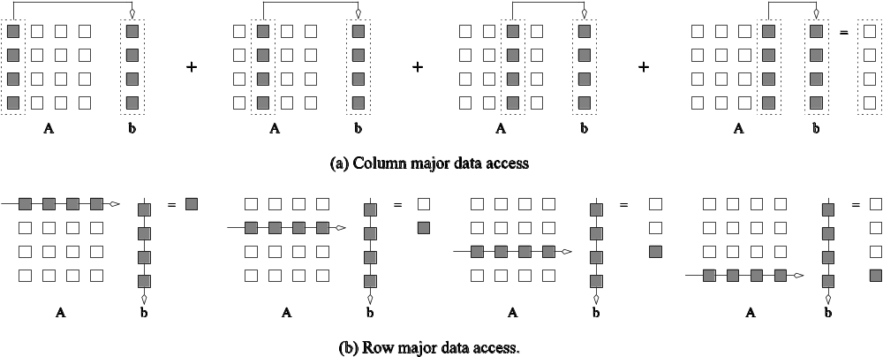
Impact of Memory Bandwidth: Example
The vector column_sum is small and easily fits into the cache
The matrix b is accessed in a column order.
The strided access results in very poor performance.
Multiplying a matrix with a vector: (a) multiplying column-by-column, keeping a running sum; (b) computing each element of the result as a dot product of a row of the matrix with the vector.

Slide 42
Impact of Memory Bandwidth: Example
We can fix the above code as follows:
for (i = 0; i < 1000; i++)
column_sum[i] = 0.0;
for (j = 0; j < 1000; j++)
for (i = 0; i < 1000; i++)
column_sum[i] += b[j][i];
In this case, the matrix is traversed in a row-order and performance can be expected to be significantly better.

Slide 43
Memory System Performance: Summary
The series of examples presented in this section illustrate the following concepts:
  Exploiting spatial and temporal locality in applications is critical for amortizing memory latency and increasing effective memory bandwidth.
  In Spatial Locality, nearby instructions to recently executed instruction are likely to be executed soon. In Temporal Locality, a recently executed instruction is likely to be executed again very soon. 2. It refers to the tendency of execution which involve a number of memory locations
  The ratio of the number of operations to number of memory accesses is a good indicator of anticipated tolerance to memory bandwidth.
  Memory layouts and organizing computation appropriately can make a significant impact on the spatial and temporal locality.

Slide 44
Alternate Approaches for
Hiding Memory Latency
Consider the problem of browsing the web on a very slow network connection. We deal with the problem in one of three possible ways:
  we anticipate which pages we are going to browse ahead of time and issue requests for them in advance;
  we open multiple browsers and access different pages in each browser, thus while we are waiting for one page to load, we could be reading others; or
  we access a whole bunch of pages in one go - amortizing the latency across various accesses.
The first approach is called prefetching, the second multithreading, and the third one corresponds to spatial locality in accessing memory words.

Slide 45
Multithreading for Latency Hiding
A thread is a single stream of control in the flow of a program.
We illustrate threads with a simple example:
for (i = 0; i < n; i++)
c[i] = dot_product(get_row(a, i), b);
Each dot-product is independent of the other, and therefore represents a concurrent unit of execution. We can safely rewrite the above code segment as:
for (i = 0; i < n; i++)
c[i] = create_thread(dot_product,get_row(a, i), b);

Slide 46
Multithreading for Latency Hiding: Example
In the code, the first instance of this function accesses a pair of vector elements and waits for them.
In the meantime, the second instance of this function can access two other vector elements in the next cycle, and so on.
After l units of time, where l is the latency of the memory system, the first function instance gets the requested data from memory and can perform the required computation.
In the next cycle, the data items for the next function instance arrive, and so on. In this way, in every clock cycle, we can perform a computation.

Slide 47
Multithreading for Latency Hiding
The execution schedule in the previous example is predicated upon two assumptions: the memory system is capable of servicing multiple outstanding requests, and the processor is capable of switching threads at every cycle.
It also requires the program to have an explicit specification of concurrency in the form of threads.
Machines such as the HEP and Tera rely on multithreaded processors that can switch the context of execution in every cycle. Consequently, they are able to hide latency effectively.

Slide 48
Prefetching for Latency Hiding
Misses on loads cause programs to stall.
Why not advance the loads so that by the time the data is actually needed, it is already there!
The only drawback is that you might need more space to store advanced loads.
However, if the advanced loads are overwritten, we are no worse than before!

Slide 49
Tradeoffs of Multithreading and Prefetching
Multithreading and prefetching are critically impacted by the memory bandwidth. Consider the following example:
  Consider a computation running on a machine with a 1 GHz clock, 4-word cache line, single cycle access to the cache, and 100 ns latency to DRAM. The computation has a cache hit ratio at 1 KB of 25% and at 32 KB of 90%. Consider two cases: first, a single threaded execution in which the entire cache is available to the serial context, and second, a multithreaded execution with 32 threads where each thread has a cache residency of 1 KB.
  If the computation makes one data request in every cycle of 1 ns, you may notice that the first scenario requires 400MB/s of memory bandwidth and the second, 3GB/s.

Slide 50
Tradeoffs of Multithreading and Prefetching
Bandwidth requirements of a multithreaded system may increase very significantly because of the smaller cache residency of each thread.
Multithreaded systems become bandwidth bound instead of latency bound.
Multithreading and prefetching only address the latency problem and may often exacerbate the bandwidth problem.
Multithreading and prefetching also require significantly more hardware resources in the form of storage.

Slide 51
Interconnection Networks for Parallel Computers
Interconnection networks carry data between processors and to memory.
Interconnects are made of switches and links (wires, fiber).
Interconnects are classified as static or dynamic.
Static networks consist of point-to-point communication links among processing nodes and are also referred to as direct networks.
Dynamic networks are built using switches and communication links. Dynamic networks are also referred to as indirect networks.

Slide 52
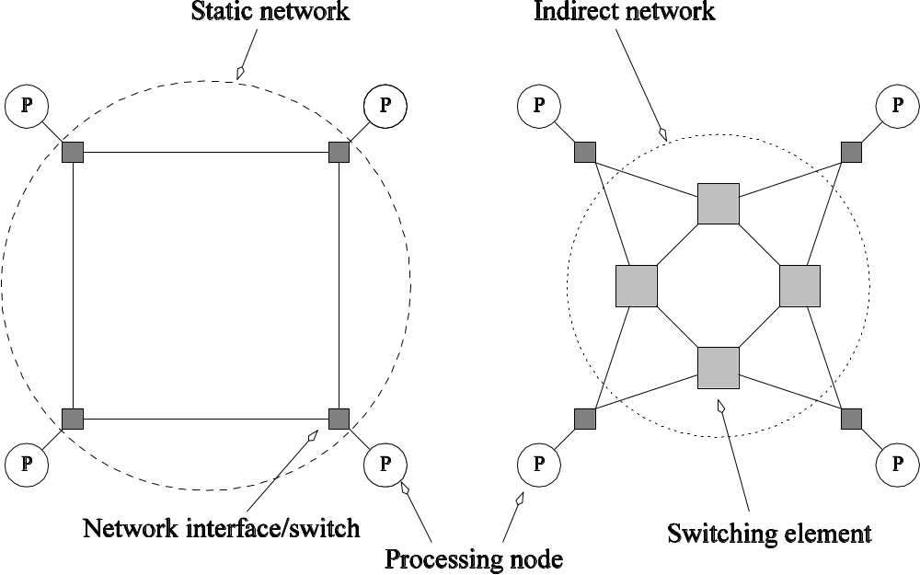
Static and Dynamic
Interconnection Networks
Classification of interconnection networks: (a) a static network; and (b) a dynamic network.

Slide 53
Interconnection Networks
Switches map a fixed number of inputs to outputs.
The total number of ports on a switch is the degree of the switch.
The cost of a switch grows as the square of the degree of the switch, the peripheral hardware linearly as the degree, and the packaging costs linearly as the number of pins.

Slide 54
Interconnection Networks:
Network Interfaces
Processors talk to the network via a network interface.
The network interface may hang off the I/O bus or the memory bus.
In a physical sense, this distinguishes a cluster from a tightly coupled multicomputer.
The relative speeds of the I/O and memory buses impact the performance of the network.

Slide 55
Network Topologies
A variety of network topologies have been proposed and implemented.
These topologies tradeoff performance for cost.
Commercial machines often implement hybrids of multiple topologies for reasons of packaging, cost, and available components.

Slide 56
Network Topologies: Buses
Some of the simplest and earliest parallel machines used buses.
All processors access a common bus for exchanging data.
The distance between any two nodes is O(1) in a bus. The bus also provides a convenient broadcast media.
However, the bandwidth of the shared bus is a major bottleneck.
Typical bus based machines are limited to dozens of nodes. Sun Enterprise servers and Intel Pentium based shared-bus multiprocessors are examples of such architectures.

Slide 57
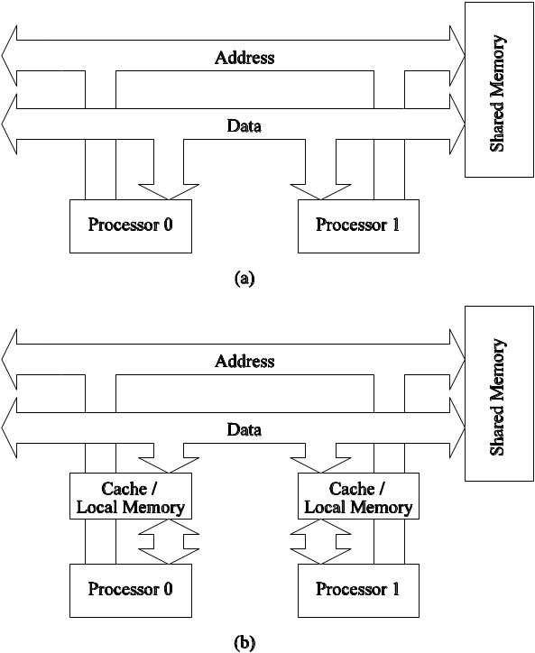
Network Topologies: Buses
Bus-based interconnects (a) with no local caches; (b) with local memory/caches.
Since much of the data accessed by processors is local to the processor, a local memory can improve the performance of bus-based machines.

Slide 58
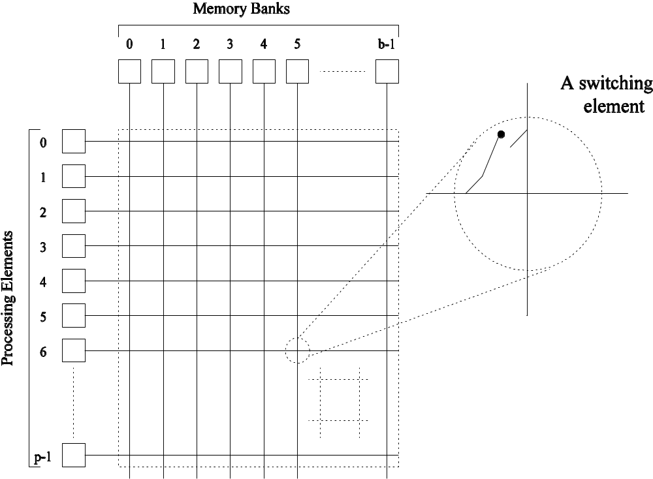
Network Topologies: Crossbars
A crossbar network uses an p×m grid of switches to connect p inputs to m outputs in a non-blocking manner.
A completely non-blocking crossbar network connecting p processors to b memory banks.

